Slide 1


From Scripts to Workflows: Orchestrating Science with Pegasus
Ewa Deelman
University of Southern California
Information Sciences Institute
deelman@isi.edu

Slide 2
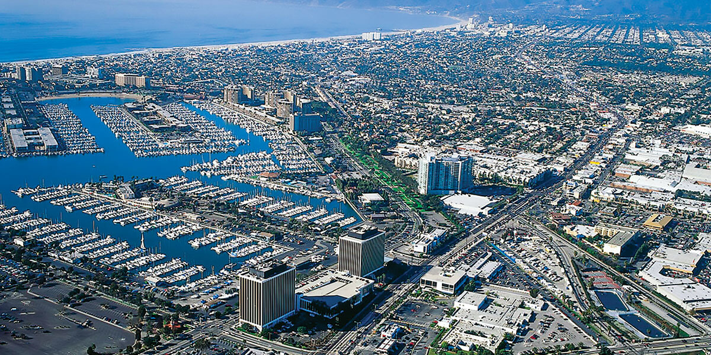
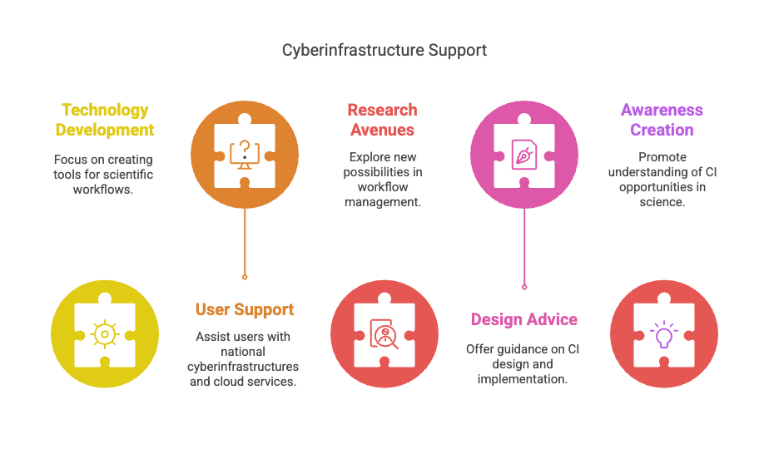
SciTech Activities
USC/ ISI
Develop technologies to support scientific workflows
Provide user support on national cyberinfrastructures and clouds
Research new avenues in the workflow management space
Provide advice on the design, implementation and use of Cyberinfrastructure (CI) for the Research Infrastructure lifecycle
Create awareness and understanding of opportunities in CI for Science
Marina del Rey, CA
Most projects are collaborative across 4-6 organizations

Slide 3
Some workflows are simple!
Bag of Tasks
Kepler periodigram workflow

Slide 4
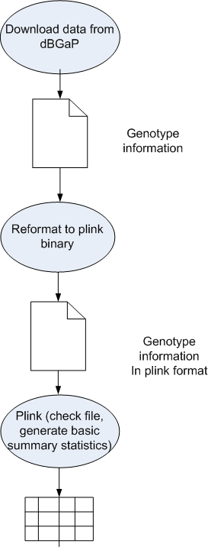
Scripts
Quick to code and deploy
Quick to learn and tailor to the local campus resource
Not very scalable, hard to move between resources, hard to maintain, hard for others to understand, often error-prone
Computational workflows
Help express multi-step computations in a declarative way
Can support automation, minimize human involvement
Makes analyses easier to run
Can be high-level and portable across execution platforms
Keep track of provenance to support reproducibility
Easier to maintain
Foster collaboration—code and data sharing
Take some time investment to learn

Slide 5
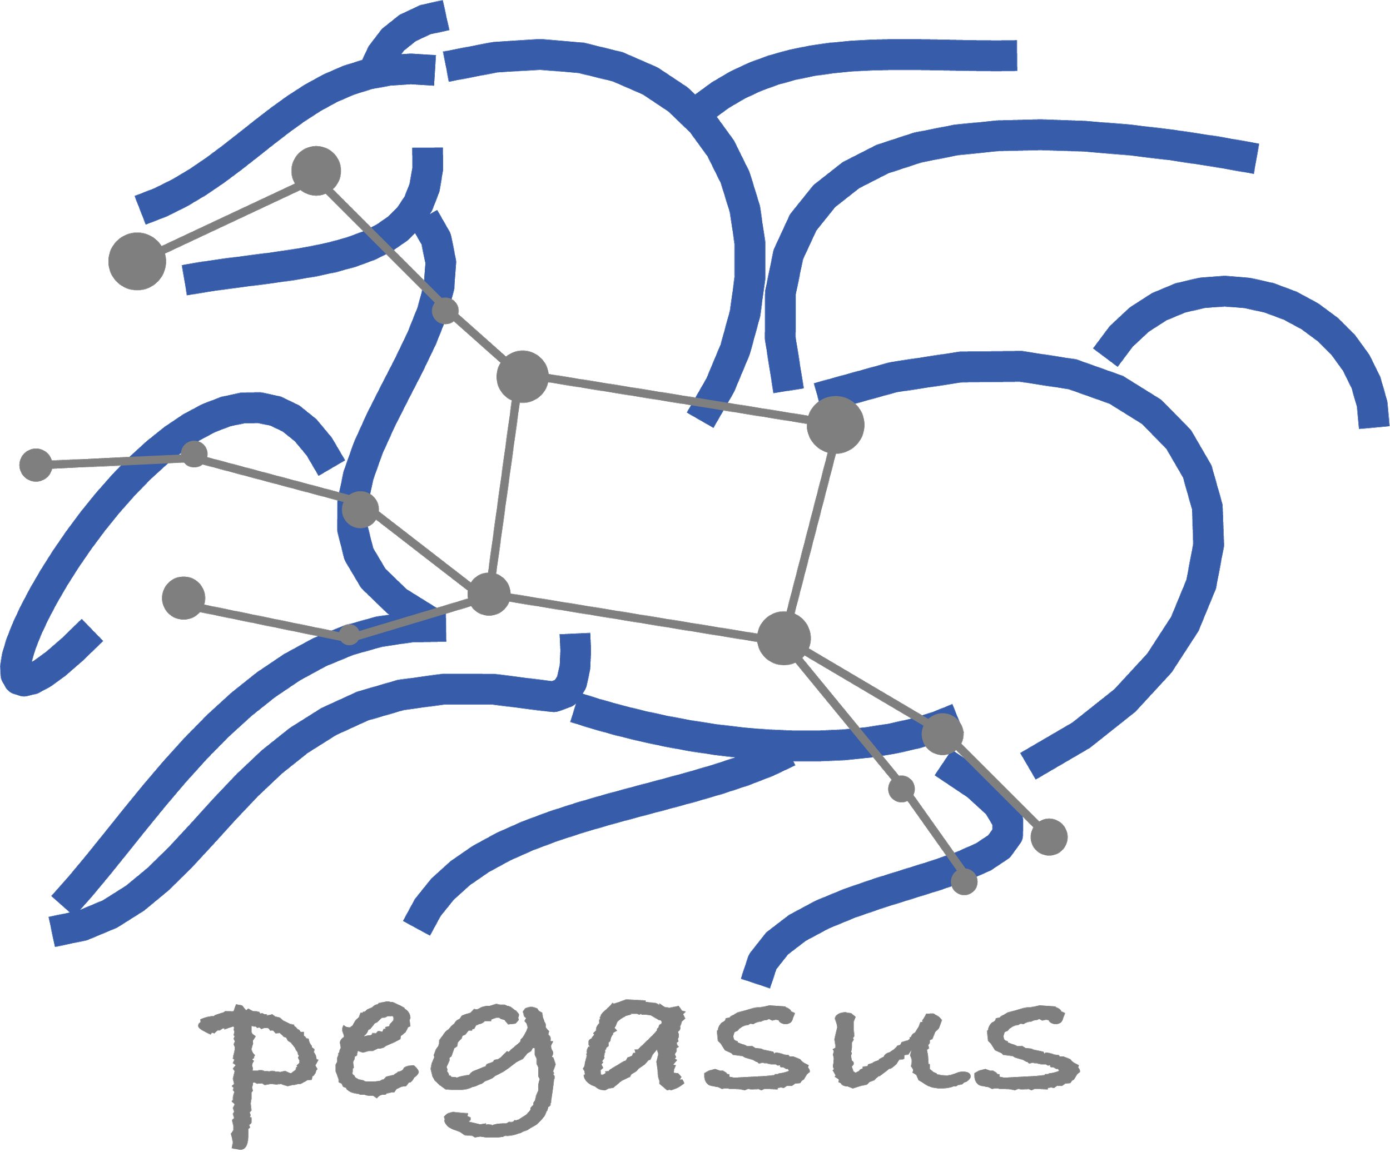
Pegasus Workflow Management System, est. 2001
Workflow Challenges Across Domains
Our Focus
Describe complex workflows in a simple way
Access distributed, heterogeneous data and resources (heterogeneous interfaces)
Deal with resources/software that change over time
Ease of use. Ability to monitor and debug large workflows
Separation between workflow description and workflow execution
Workflow planning and scheduling (scalability, performance)
Task execution (monitoring, fault tolerance, debugging, web dashboard)
Workflow optimization, restructuring for performance and fault tolerance.

Slide 6
Submit locally, run globally
SUBMIT HOST
Compute Site 1
Input Data Site
Pegasus WMS ==
Pegasus planner (mapper) + DAGMan workflow engine + HTCondor scheduler/broker
F.in
Pegasus Lite
Instance
F.in
J1
T1
T1
Pegasus maps workflows to target infrastructure (1 or more resources)
DAGMan manages dependencies and reliability
HTCondor is used as a broker to interface with different schedulers
F.int
WN
WN
T2
Compute Site n
Staging Site
Pegasus Lite
Instance
F.int
F.out
J2
T2
Output Data Site
F.out
Planning converts an abstract workflow
into a concrete, executable workflow
WN
WN
Planner is like a compiler
Optimized performance
Provides fault tolerance
LEGEND
Task flow +
Checksums
Directory
Setup Job
Data
Stageout Job
Check
Integrity Job
J
Pegasus Lite Compute Job
Data Flow
Data
Stagein Job
Directory
Cleanup Job
Checksum Generation Job
Worker Node
(WN)
Can leverage distributed and heterogeneous CI
WN

Slide 7
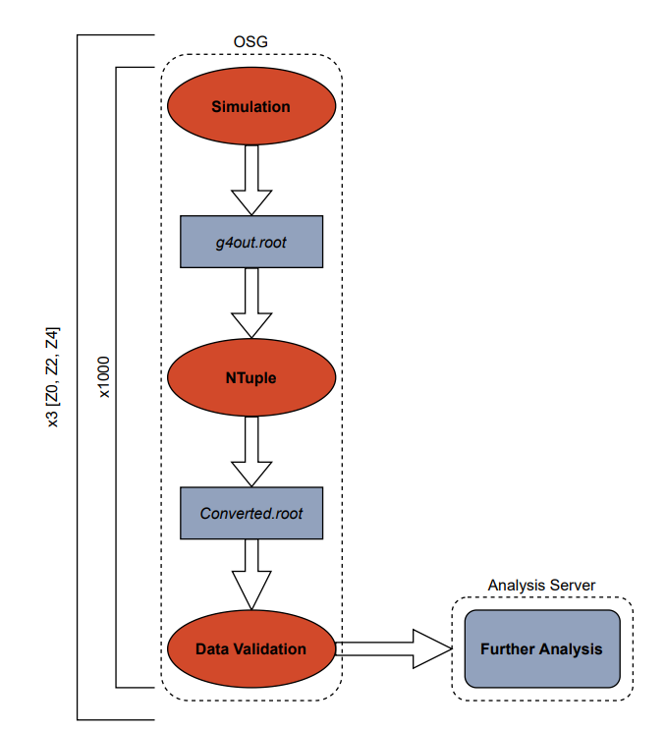
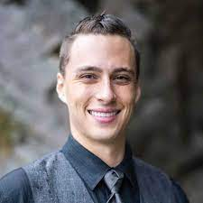
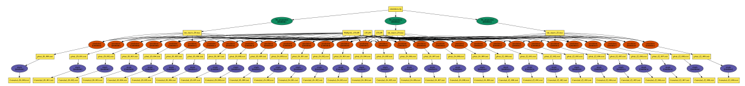
From a proof of concept to winning the 2022 David Swanson Memorial Award
Connor Natzke,
Physics Student
Colorado School of Mines
Investigation of the strong nuclear force
Pegasus-based Monte-Carlo simulation, 590,000 jobs, 15 years total wall time, 4 hours wall time on Open Science Grid
Pegasus provided:
Automation and scaling
Automatic job retries
Automation of file transfers
Managed disk space at execution sites
Notes:
And they can go from a proof of concept to large-scale computations
AWARD bestowed annually upon one or more former students of the OSG User School who have subsequently achieved significant dHTC-enabled research outcomes
Physics students

Slide 8
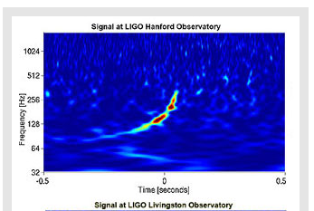
Workflows Can Move with Time
Pegasus use in
the Laser Interferometer Gravitational Wave Observatory
Nobel
Prize
2001
2017
2002
2003
2004
2005
2006
2007
2008
2009
2010
2011
2012
2013
2014
2015
2016
First Pegasus prototype
Blind injection detection
First detection of black hole collision
Multi-messenger neutron star merger observation
Image credit: LIGO Scientific Collaboration

Slide 9

Pegasus for Seismic Hazard Applications
45
55K
125K
Days
Frontier
Frontera
Duration of 24/7 operation
Node-hours
Node-hours
GPUs
CPUs
High-water marks were 4130 nodes on Frontier (44%) and 1029 nodes on Frontera (12%)*
1 PB
9M
945
Useful information
for:
Data
Files
Workflows
Building engineers
Disaster planners
Insurance agencies
Managed by Pegasus
Staged to USC CARC
27,720 jobs
Two new Northern California hazard models were produced.
Slide Courtesy of Scott Callaghan, USC
* Neither used a reservation or priority bump.
Notes:
We ran for 45 days, around the clock.
The study used about 55k node-hours on Frontier and 125k node-hours on Frontera.
Our high-water marks were 4130 nodes on Frontier (44%) and 1029 nodes on Frontera (12%). Neither used a reservation or priority bump.
Pegasus managed about 1 PB of data.
We staged about 9 million output files totaling 36 TB back to long-term storage at USC CARC.
We ran 945 top-level workflows, with an average of 15 running at a time.
We ran approximately 27,720 jobs. Of these, 7245 were remote, 8190 were local, 5985 were directory creation, 5355 were staging, and 945 were registration.
We produced two new hazard models for Northern California.
For each of 315 sites, we are executing 3 workflows. The first calculates the Strain Green Tensors, the wave propagation output. Since the wave propagation code, AWP-ODC, is a GPU code (with CUDA and HIP implementations), we run these workflows on Frontier, and Pegasus stages the SGTs from Frontier to Frontera, approximately 330 TB in total staged data. Next we run a low-frequency seismogram synthesis workflow on Frontera; this uses a manager-worker tightly coupled MPI CPU code. Lastly we run a broadband seismogram synthesis workflow, also on Frontera. This uses PMC to run a wide but shallow set of tasks with some dependencies. These codes are all CPU.
We ran the SGT workflows first. As they finished, we used the SGTs to generate the low-frequency seismogram synthesis, and prioritized finishing up all the low-frequency calculations first. Then, we ran the broadband workflows for all the sites.
Most of the remote jobs were MPI jobs, either GPU (wave propagation) or CPU (seismogram synthesis). There are a handful of serial jobs run as part of the pre- and post-processing before the large MPI jobs.

Slide 10
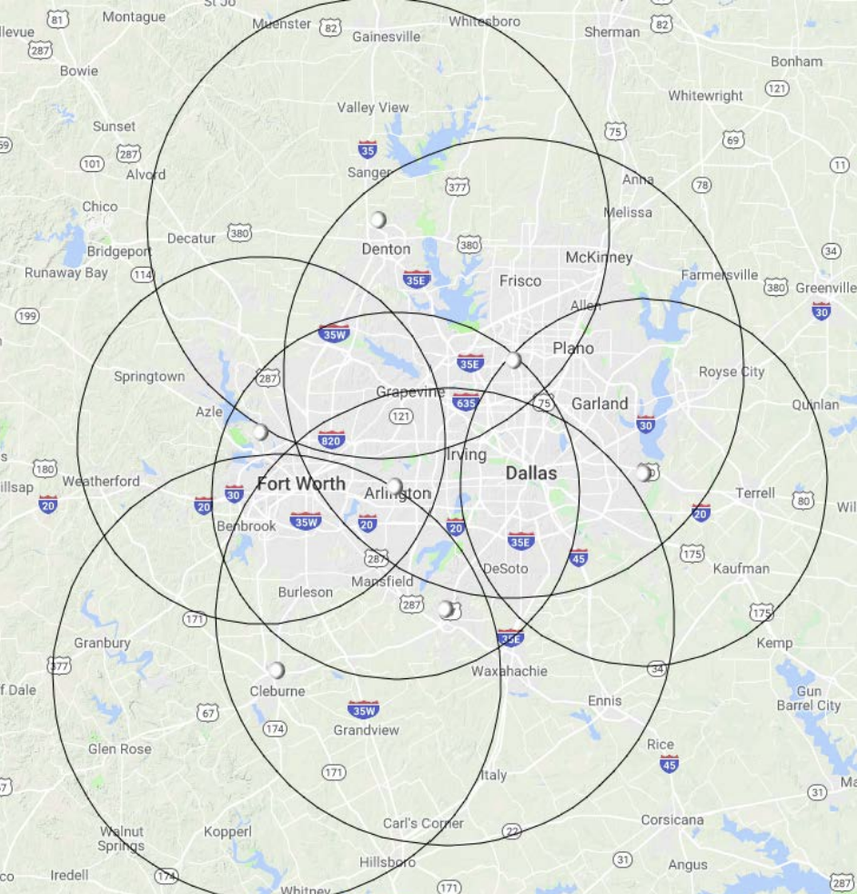
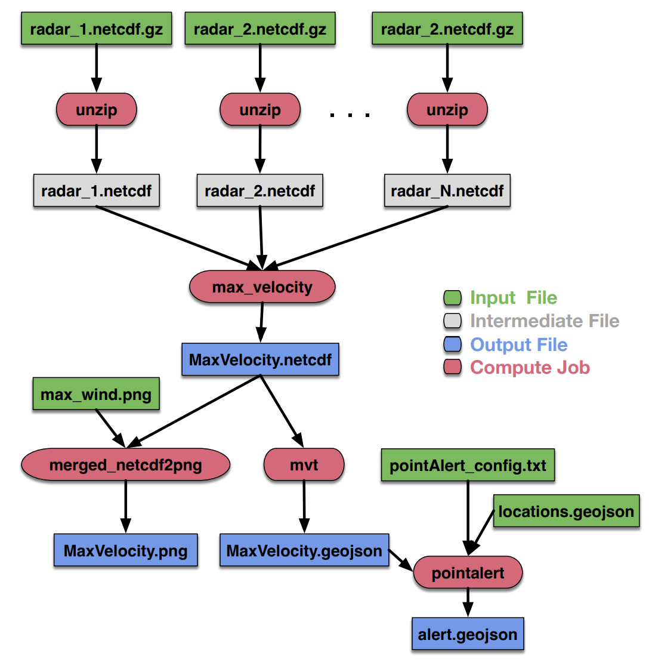
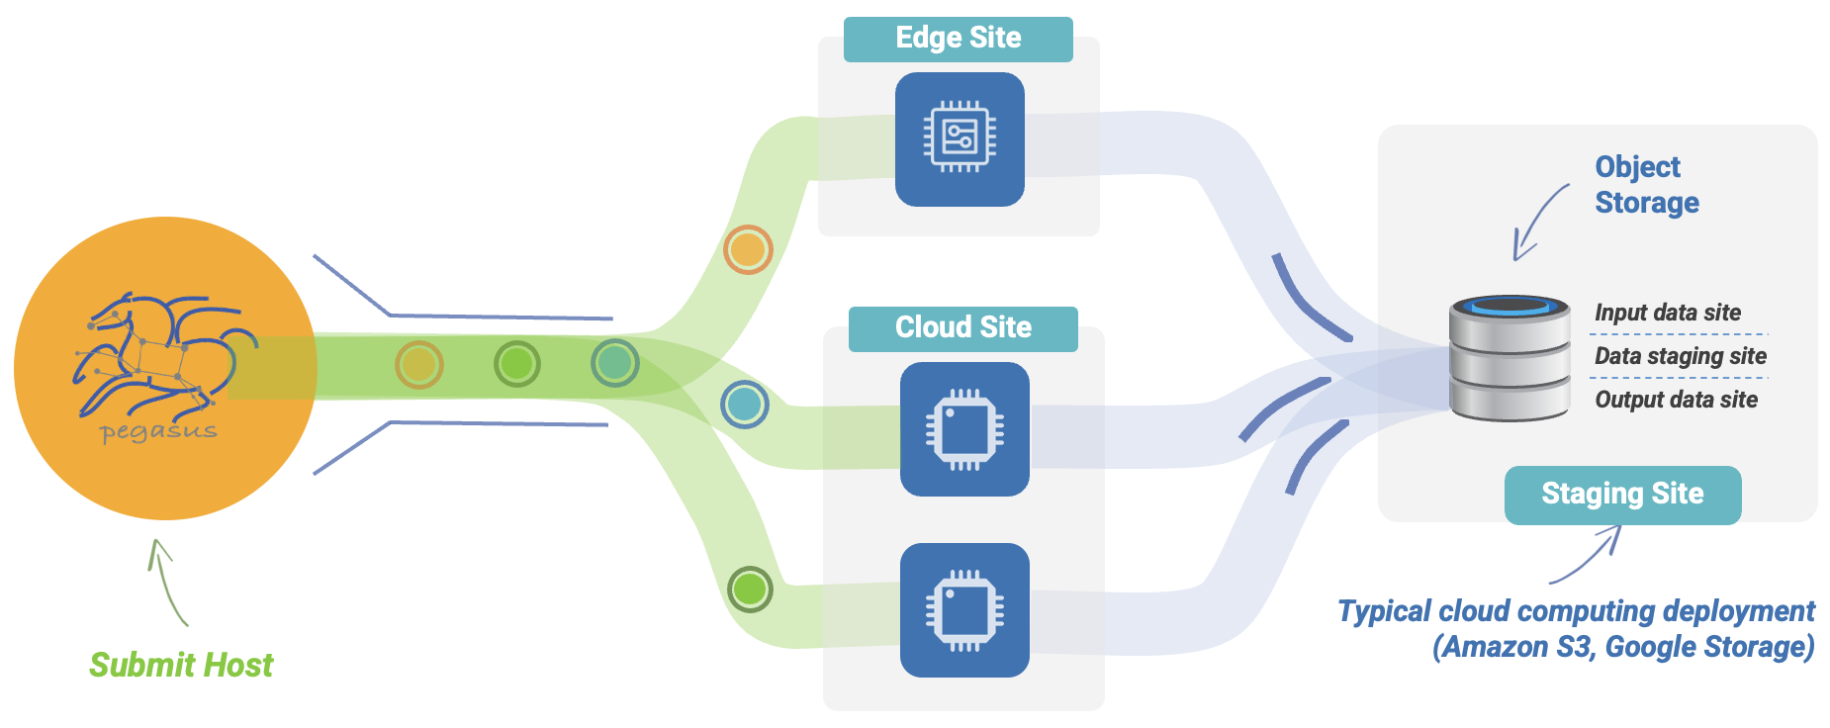
Edge-2-Cloud Applications
CASA: Collaborative and Adaptive Sensing of the Atmosphere
Has deployed a network of short-range Doppler radars
Compute and data repositories at the edge, close to the radars
Use on demand cloud resources to scale up their computations
Runs at the Edge
http://www.casa.umass.edu/
Decoupling of compute and storage

Slide 11
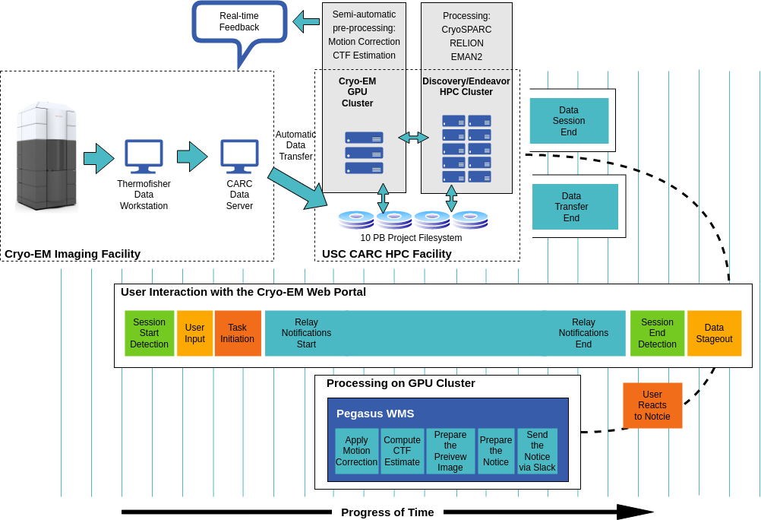
Processing instrument data in real time
Totally hidden from the user
Curated, pre-defined workflow
Automated data transfers
Automation of pre-processing
Quick feedback during experiments
Used in production at USC
Hidden workflows
Explicit workflow construction
Pegasus
Workflow Management System
https://pegasus.isi.edu /

Slide 12
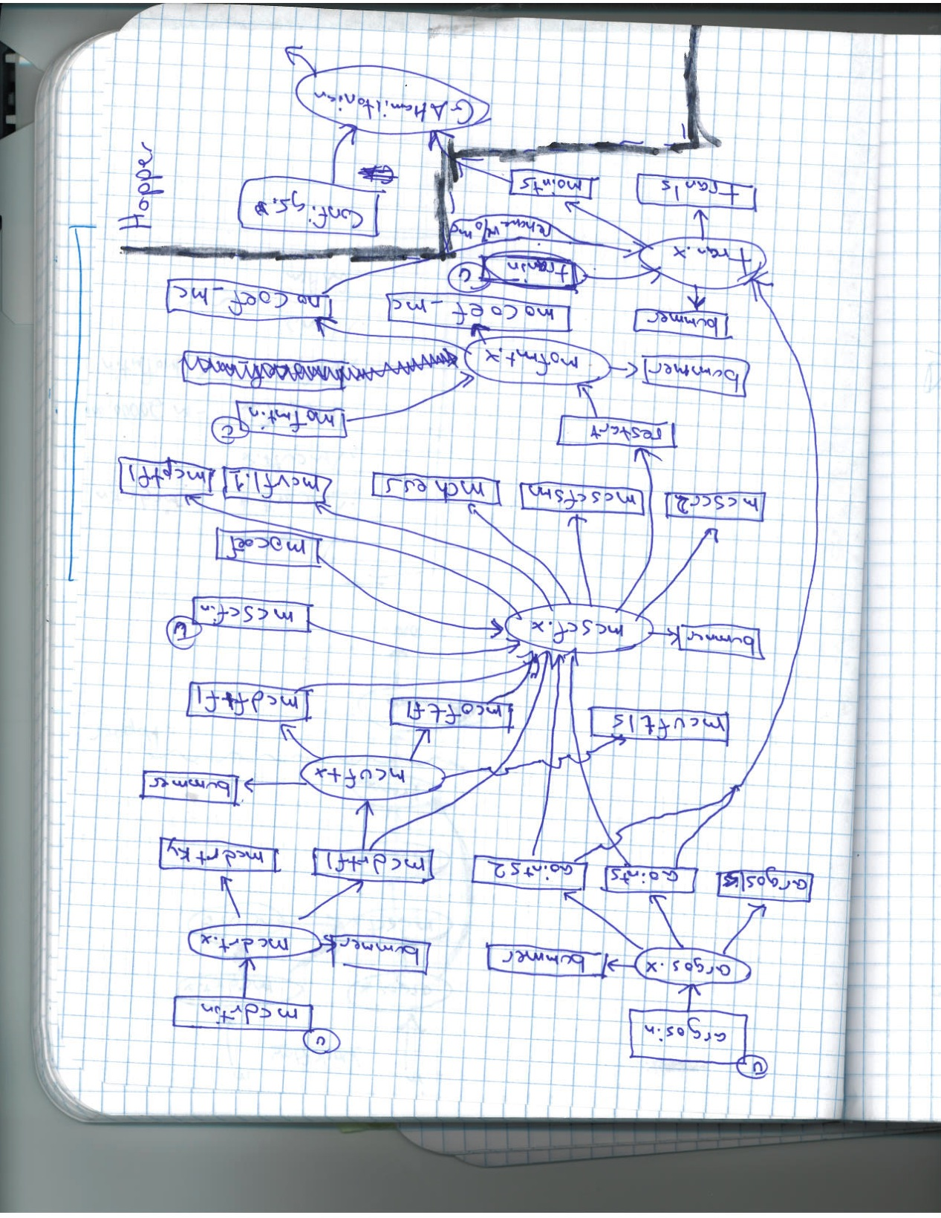
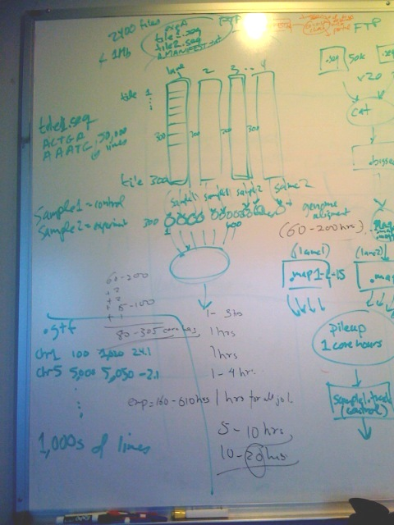
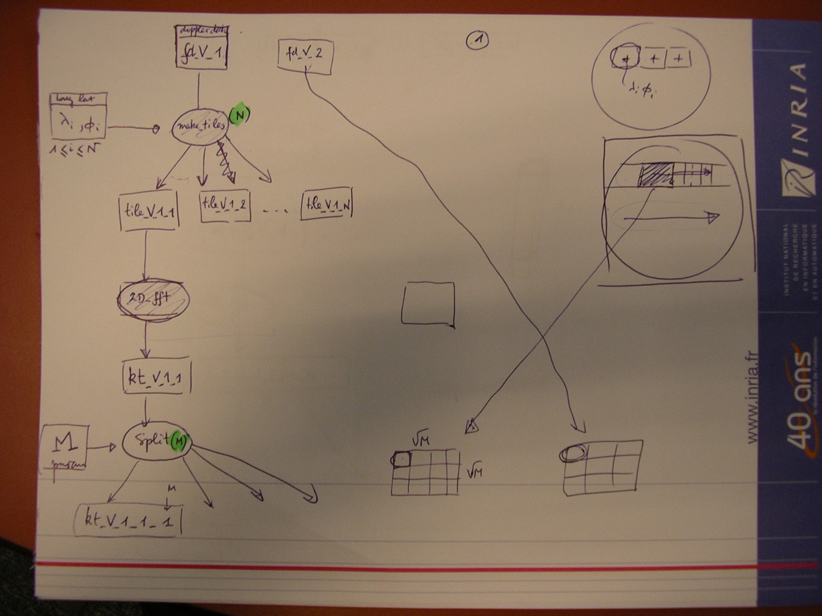
How do workflows start?
Pegasus provides tools and APIs to create workflows
using Python, Java, R and support Jupyter Notebooks

Slide 13
Pegasus Planning: Challenges and Solutions for Improving Performance and Robustness
Distributed execution environment
Design custom workflow engines and utilize the right tools for job submission and data management
Workflow tasks can be small
Increase the tasks’ computational granularity through task clustering
Workflows can be large
Reduce the number of tasks through workflow partitioning
Overcome system and network overheads in executing applications remotely
Provision resources and/or send more work at any one time
Data need to be moved to the computation
Discover data and stage it across heterogeneous systems
Computations need to be moved to the data (performance/privacy)
Make smart decisions, explore benefits/drawbacks

Slide 14
Pegasus Workflow Execution: Challenges and Solutions for Fault Tolerance
Computations fail within a workflow
Automatically checkpoint the workflow, automate restart
Resources fail
Automatically retry, or replan: try other resources (computing sites, data storage systems)
Services fail (data movement, data registration)
Retry the action, choose a different service
Run out of resources/Storage gets filled up
Analyze the workflow and clean up data no longer needed as the workflow execution progresses
Data gets corrupted
Detect corruption/retry transfer
Data “cleanup”
stage-in
preprocess
findrange
cleanup
analyze
stage-out
cleanup
registration

Slide 15
Challenge | Pegasus’ Solution
Staging data | Automated data transfer to and from computations
Different storage systems | Pegasus can talk a number of protocols, including HTTP, FTP, Globus Online, HTCondor and others
Small workflow tasks | Pegasus can cluster tasks together for more efficient execution
Limited storage (edge) | Pegasus analyzes the workflow and cleans up data no longer needed
Failures during execution | Job retries, trying different data sources, workflow-level checkpoint, rescue DAGs
Have a full workflow, but some data was already computed | Pegasus can re-use that data and run only the necessary jobs
Don’t know what happened during the execution | Pegasus has tools for analyzing workflow performance and help debug them, pinpointing errors
Pegasus keeps track of how the result was obtained: Full Provenance, support for containers

Slide 16

ACCESS CI provides researchers with:
High-Performance Computing (HPC) : NCSA Delta, Purdue Anvil, TACC Frontera, SDSC Expanse, PSC Bridges2, …
High-Throughput Computing (HTC): OSPool (Open Science Pool)
Cloud & Interactive Platforms: IU Jetstream2 for on-demand VMs and analysis
Data & Storage Services: Shared storage, data movement, OSN (Open Storage Network)
Networking & Middleware: Fast research network connections and software services
Expert Support: Consulting and training to optimize codes, workflows, and data

Slide 17
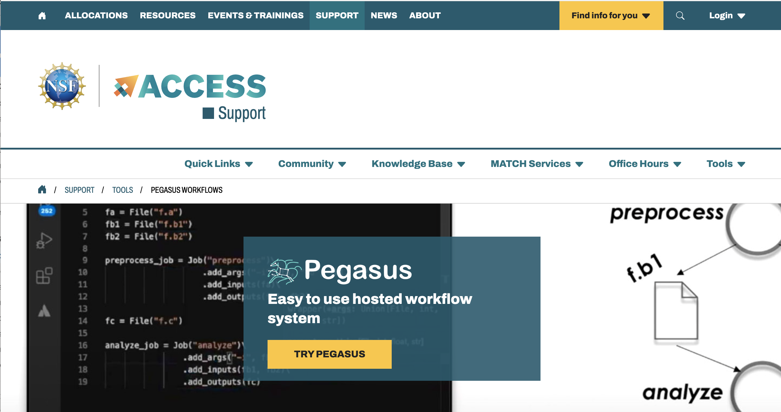
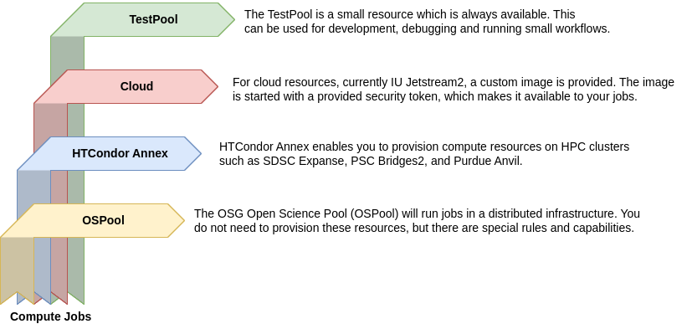
Get an account on ACCESS and visit the Support Page
You don’t need an allocation to try Pegasus

Slide 18
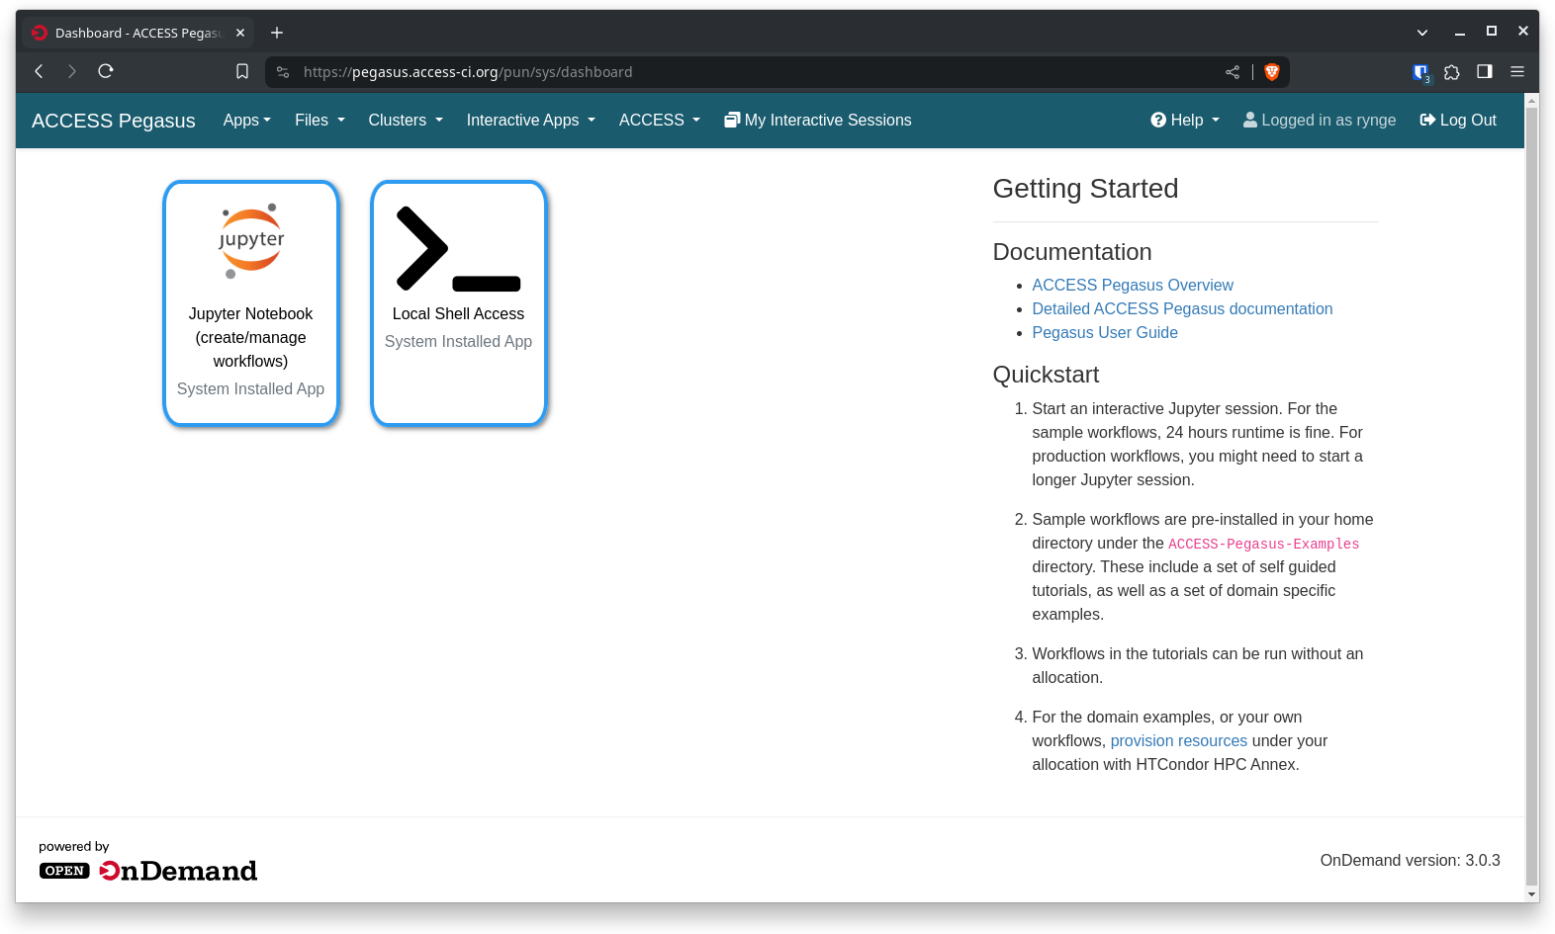
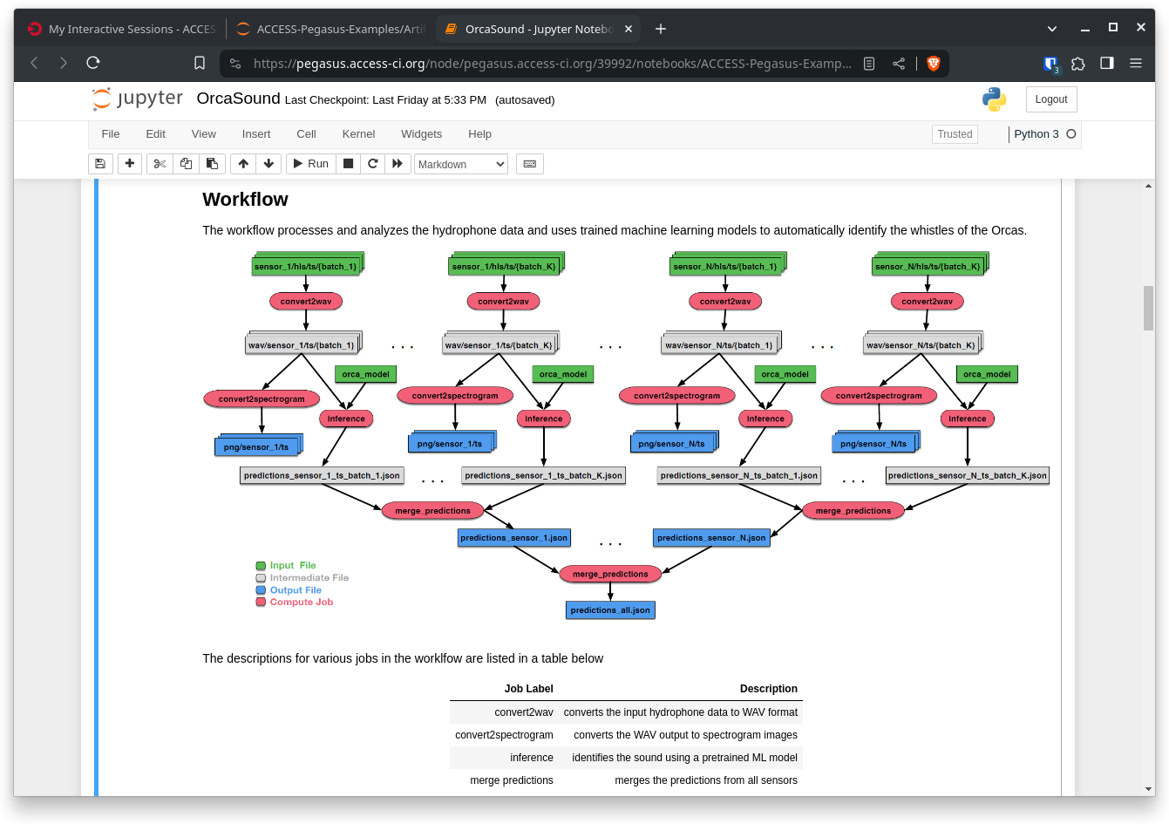
ACCESS Pegasus
Leveraging Open OnDemand and Jupyter Notebooks to to broaden access to Pegasus’ capabilities

Slide 19
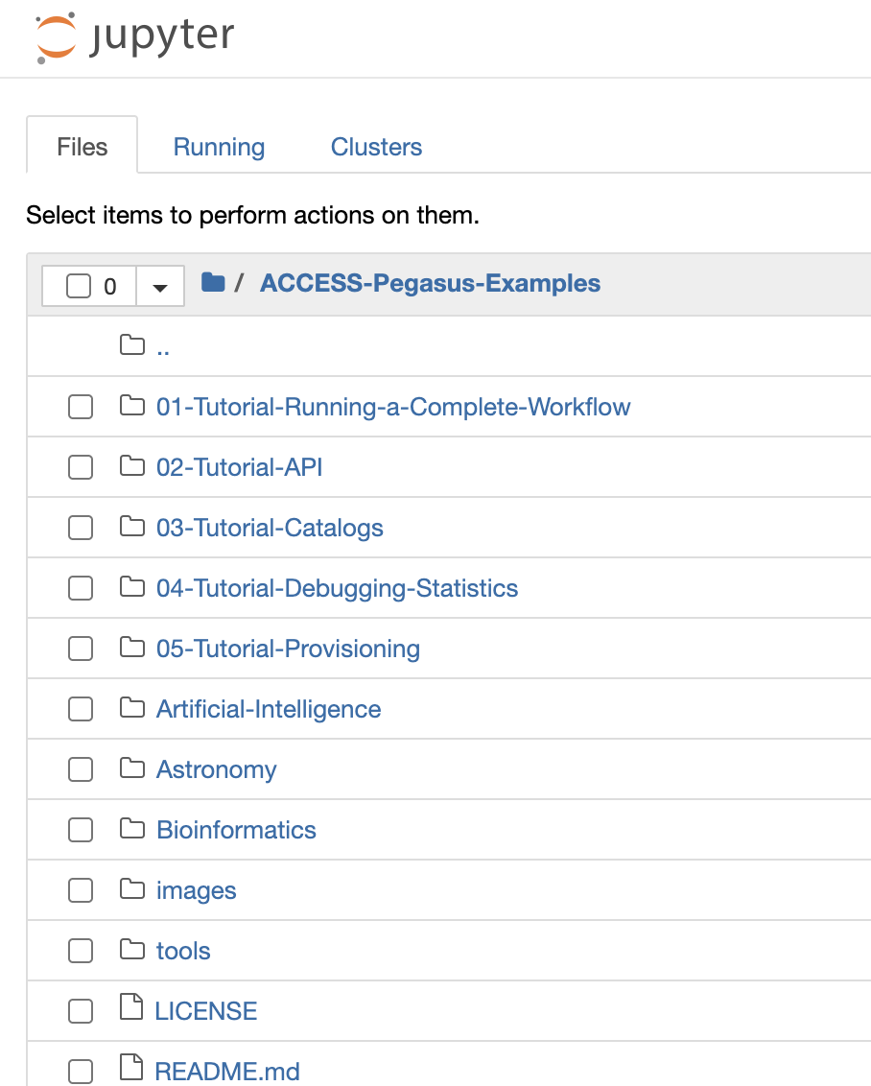
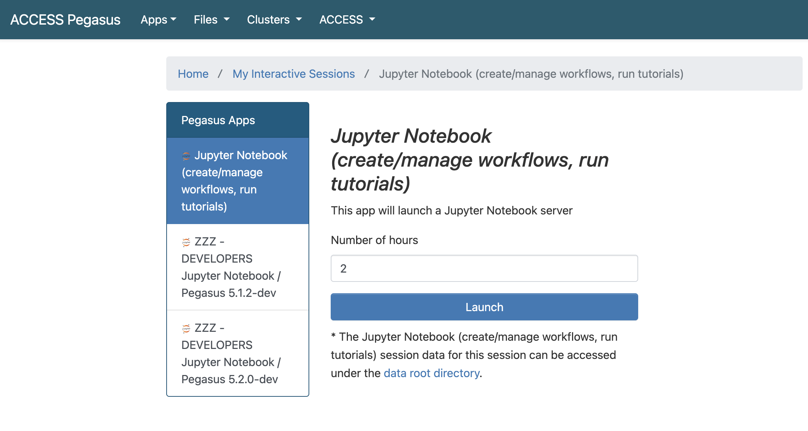
Jupyter-Notebook Self-Paced Tutorials and Examples

Slide 20
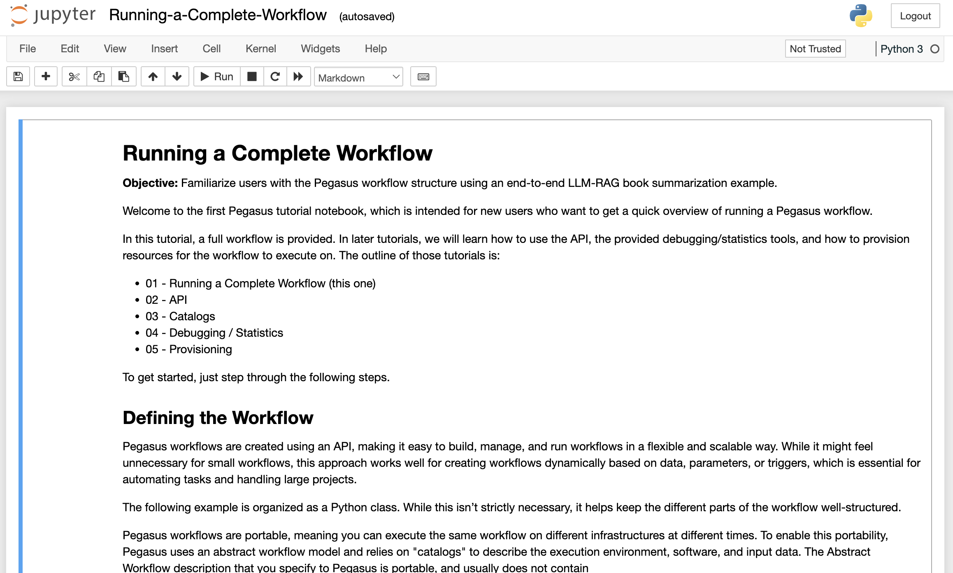
Jupyter-Notebook based Self-Paced Tutorials and Examples

Slide 21

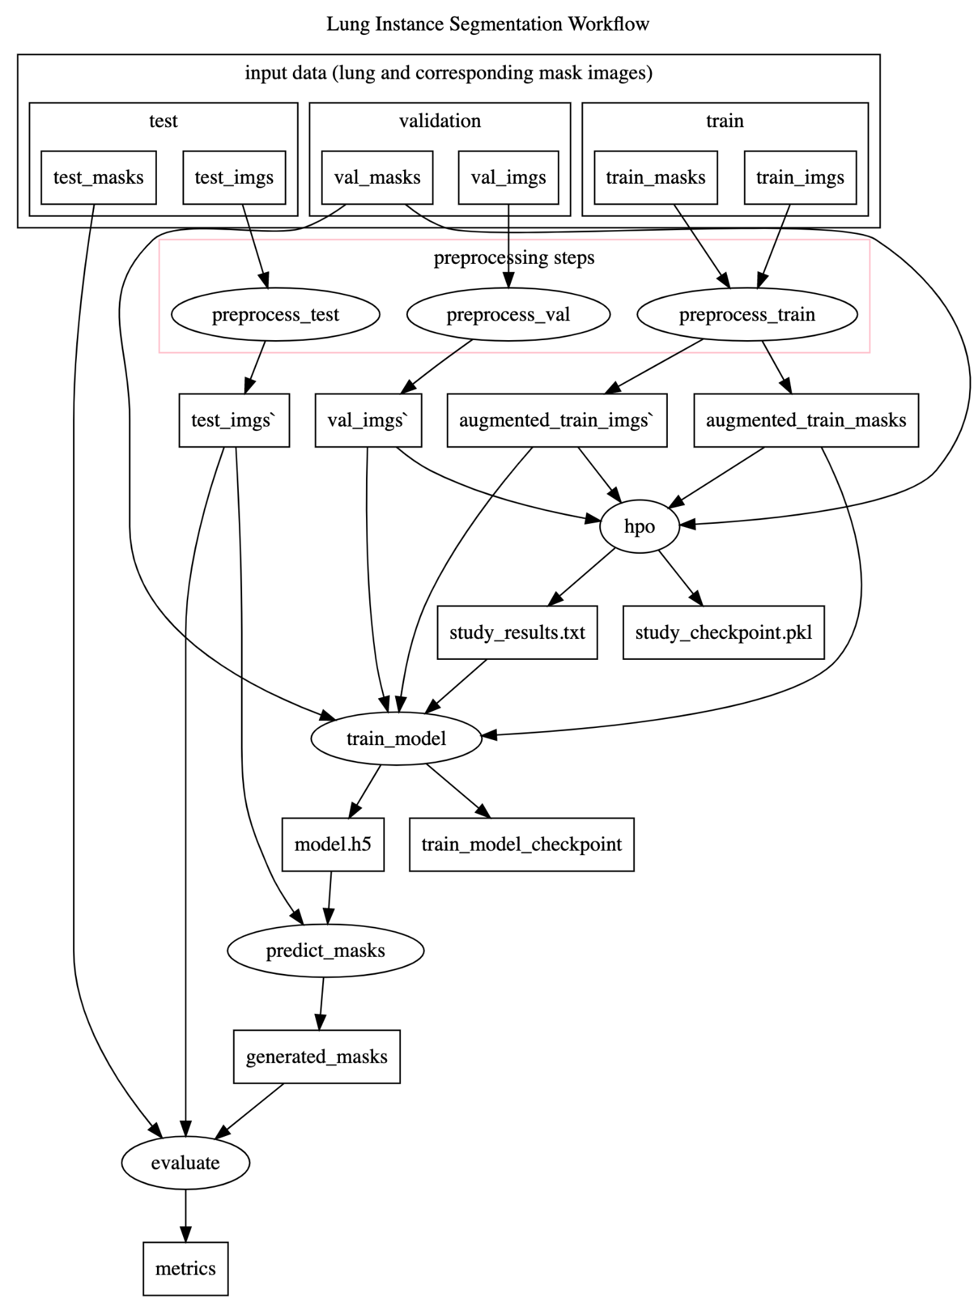
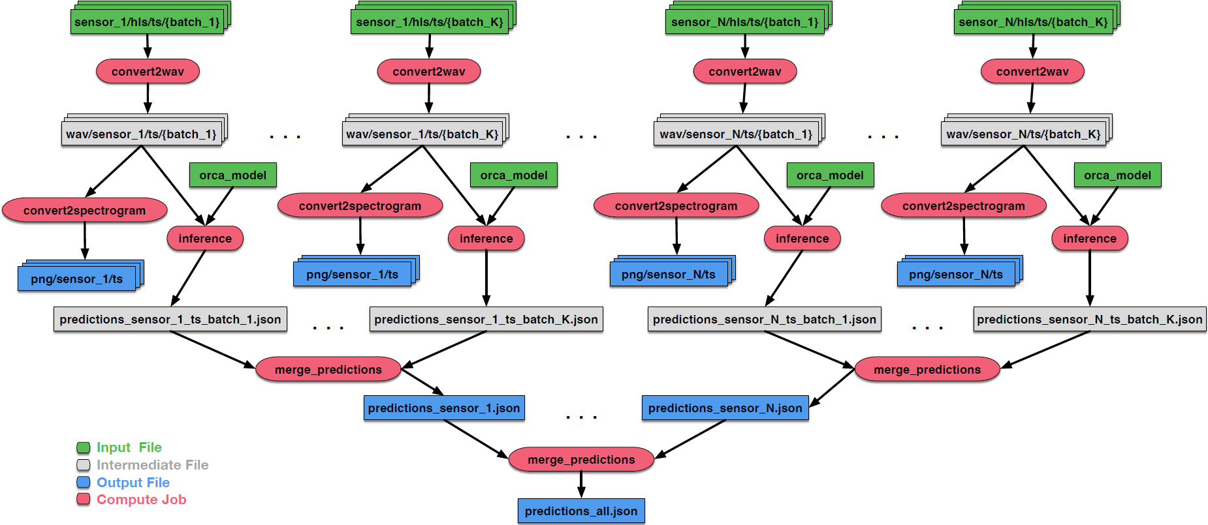
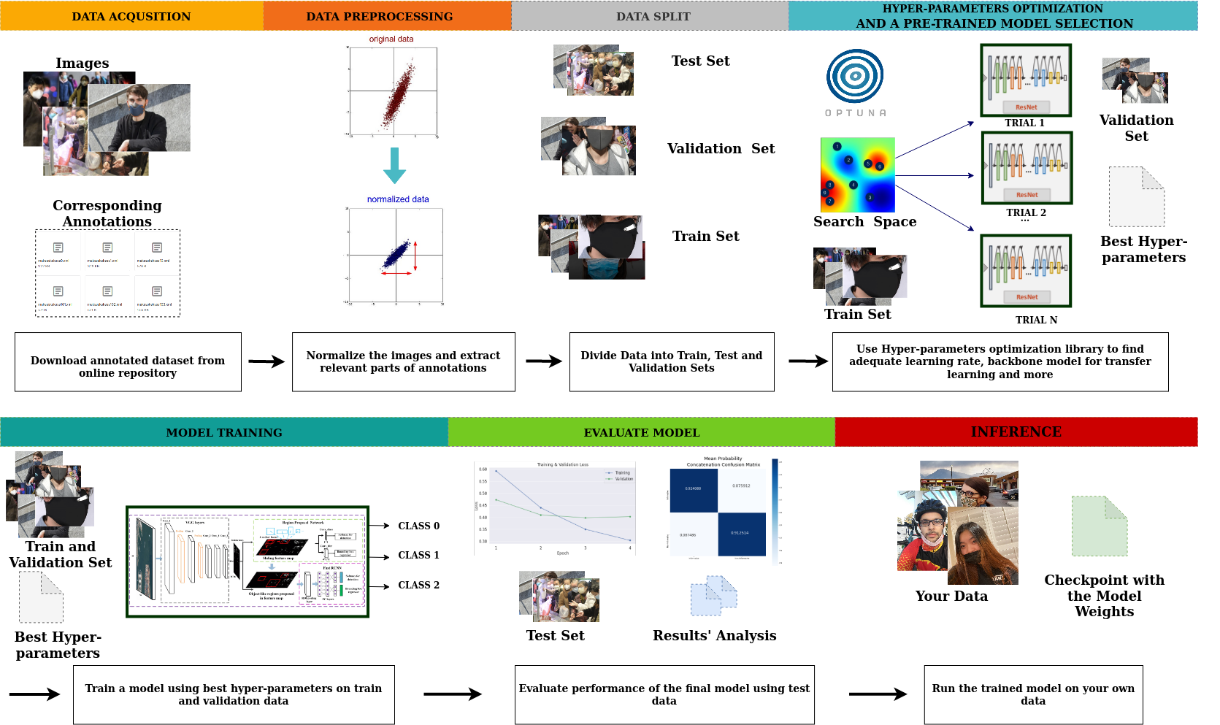
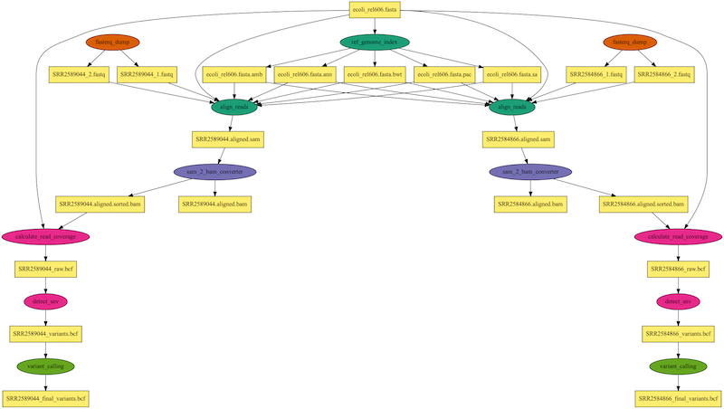
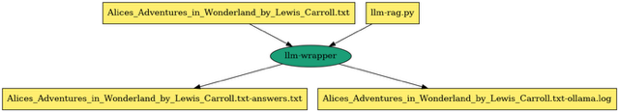
AI Workflows
Orca Sound
Lung segmentation
Mask detection
Variant calling
LLM + RAG

Slide 22
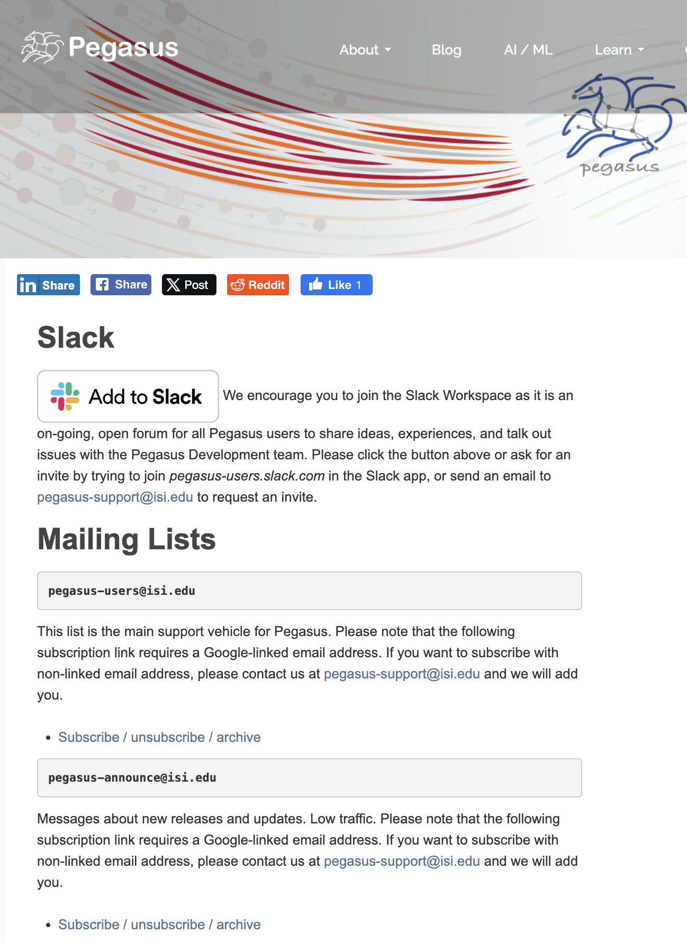
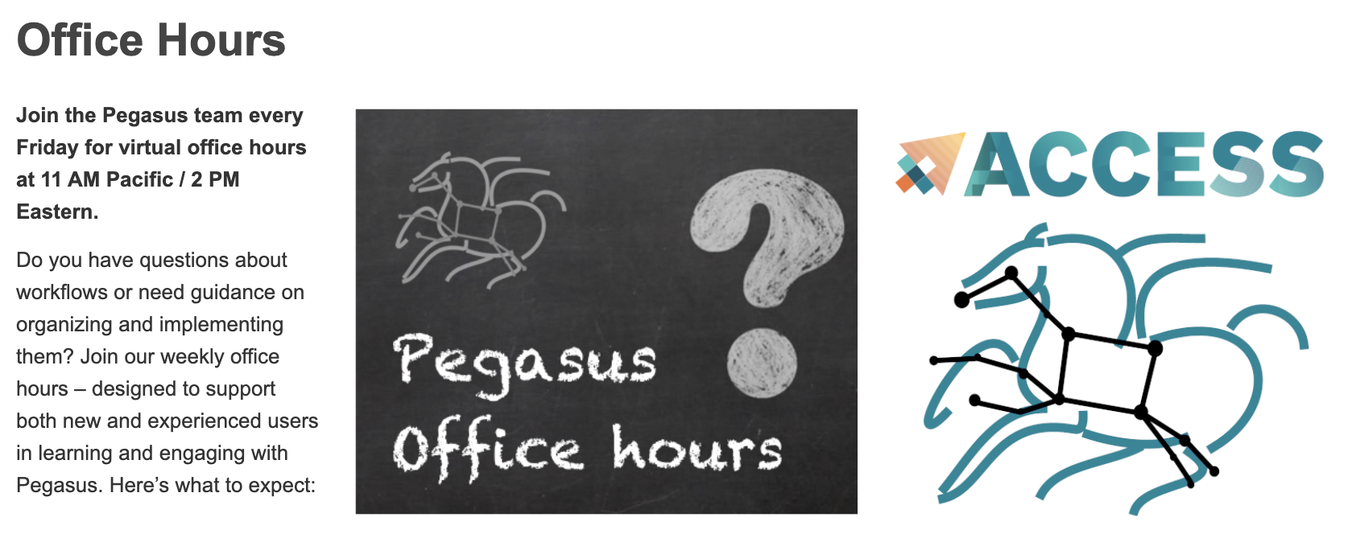
Engage with us!
Slack channel
Email: pegasus-support@isi.edu
Office hours every Friday
Tutorial walkthrough First Friday of the month
http://pegasus.isi.edu
We can help you get started!

Slide 23

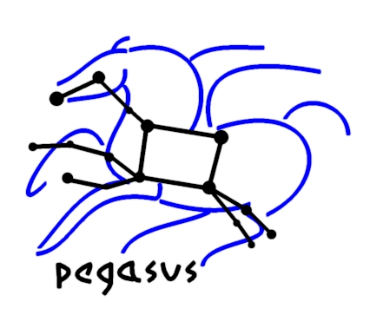
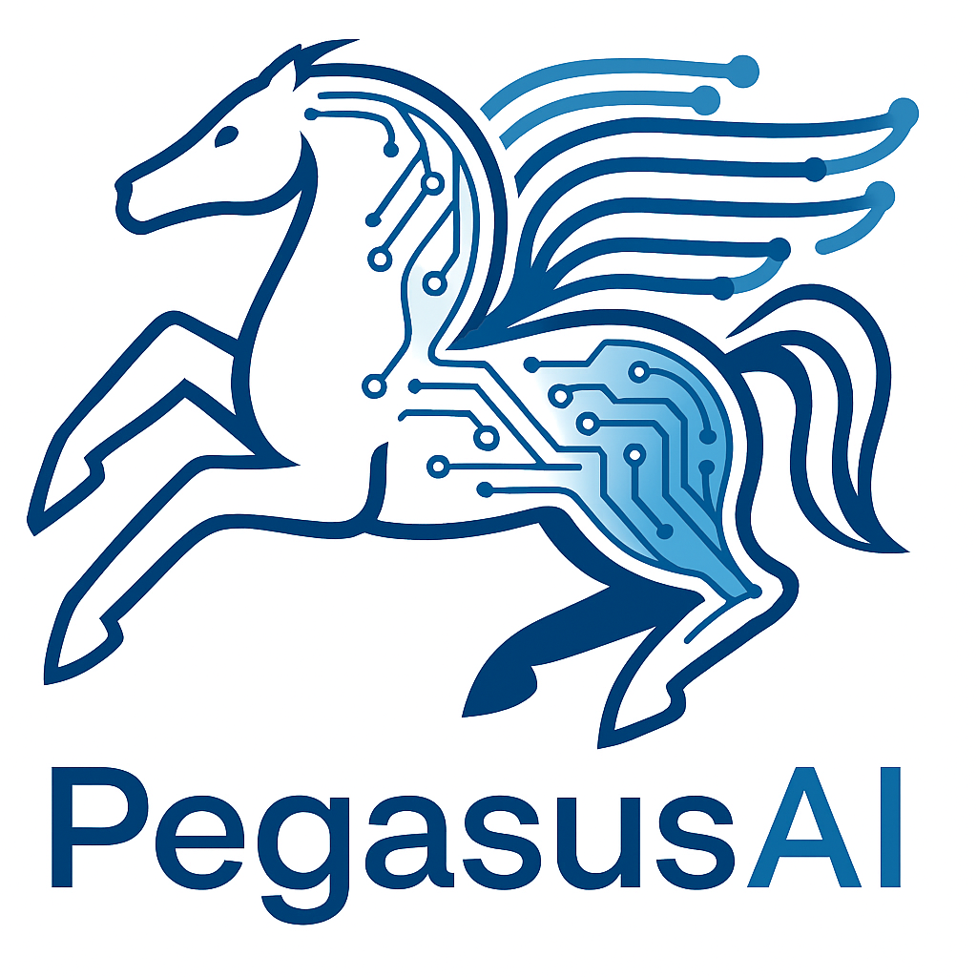
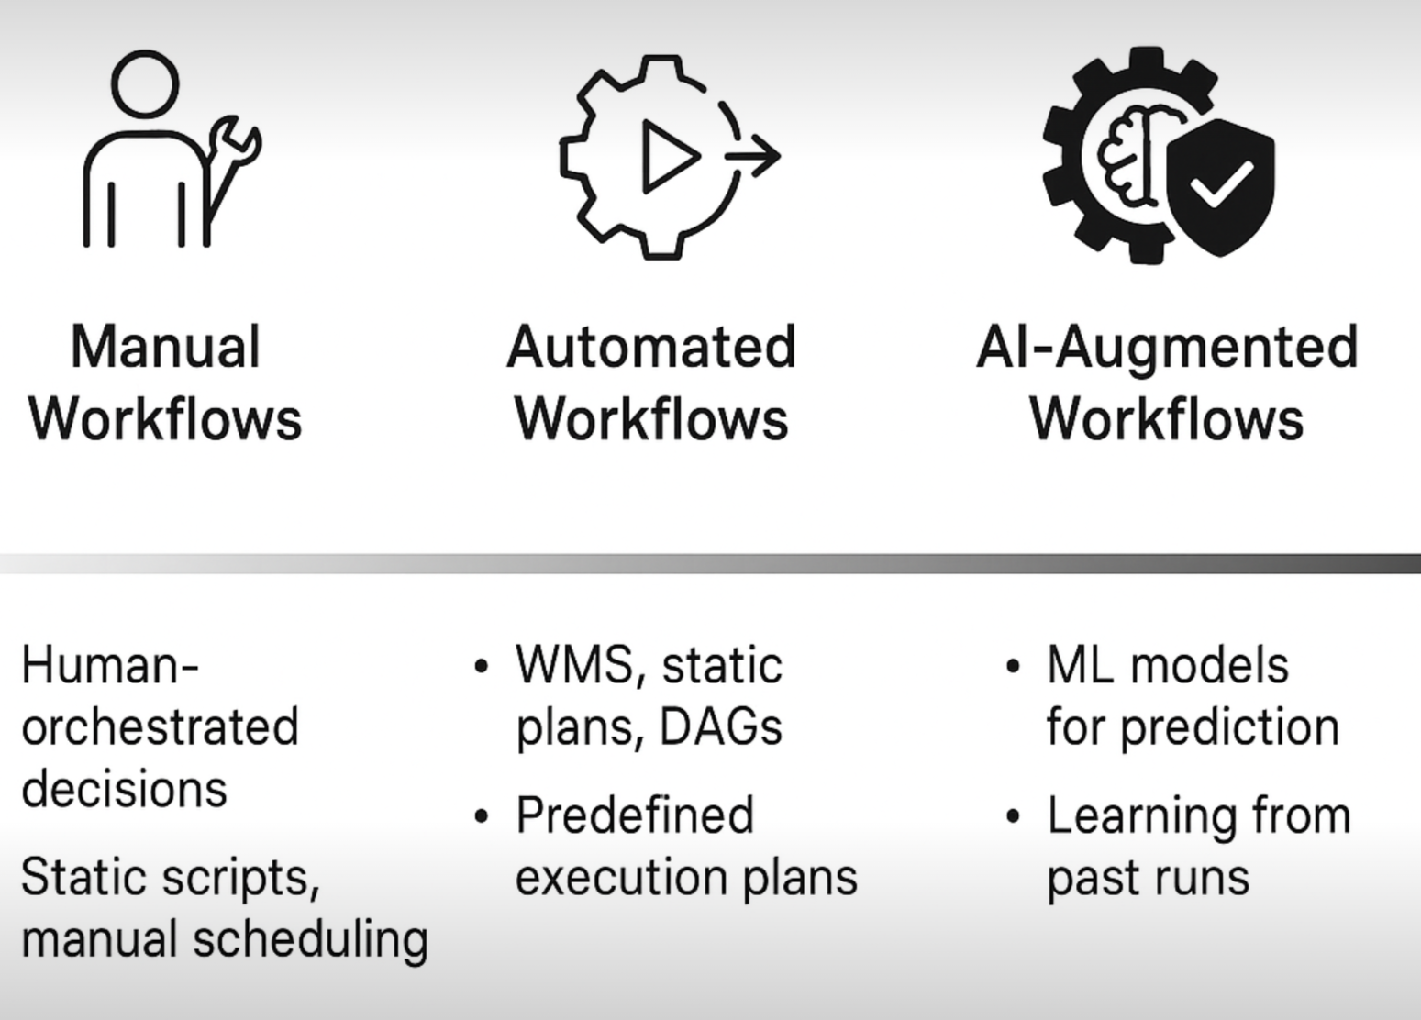





2025 - 2030
Create Workflow
Modify
Publish
Results
Plan
Workflow
AI models to support decision making and
user experience
Adapt
Monitor
Provision
Resources
Execute
Workflow
Workflow composition
Resource need and performance prediction
Anomaly detection
Dynamic workflow execution adaptation
Learn about the workloads and systems
Predict/design systems to serve the workflows

Slide 24
PegasusAI Plans
Intelligent Resource Planning: Uses machine learning models to predict resource needs and optimize workflow execution.
Adaptive Workflow Management: Detects anomalies and performance issues in real time, automatically adjusting plans or alerting users.
Human-in-the-Loop Design: Guides researchers through AI-augmented tools for workflow creation, monitoring, and debugging.
Scalable Across CI: Supports execution on HPC, cloud, and edge platforms, enabling flexible deployment and broad applicability.
AI-Ready Data Generation: Provides curated datasets and trained models to advance AI for scientific computing and CI research.

Slide 25
Pegasus Analyzer
Next major version of Pegasus will have AI assistant
Current version of analyzer pinpoints and highlight failures. Example:
2025-09-25 19:10:16,985 INFO: /bin/cp -f -R -L '/home/rynge/ACCESS-Pegasus-Examples/04-Tutorial-Debugging-Statistics/bin/llm-rag.py' '/home/rynge/ACCESS-Pegasus-Examples/04-Tutorial-Debugging-Statistics/scratch/rynge/pegasus/llm-rag-books/20250925T190853+0000/./llm-rag.py'
2025-09-25 19:10:16,991 ERROR: Expected local file does not exist: /home/rynge/ACCESS-Pegasus-Examples/04-Tutorial-Debugging-Statistics/inputs/Alices_Adventures_in_Wonderland_by_Lewis_Carroll.txt
We are adding a Pegasus AI assistant to help interpret the errors.

Slide 26
Next major version of Pegasus will have AI assistant
============================= Pegasus AI Analysis ==============================
The workflow failed due to a missing input file. The job `stage_in_local_local_0_0` encountered an error:
**"Expected local file does not exist: /path/to/Alices_Adventures.txt"**
**Root Cause:**
- The required input file is missing from the specified path.
- This prevents the transfer process from completing, causing the workflow to fail.
**Next Steps:**
1. Verify the file exists at the specified path.
2. Ensure the file path in the workflow configuration matches the actual location.
3. Resubmit the workflow after resolving the file issue.
The remaining unsubmitted jobs (7 total) likely depend on this staged file, so fixing this error will enable further execution.

Slide 27

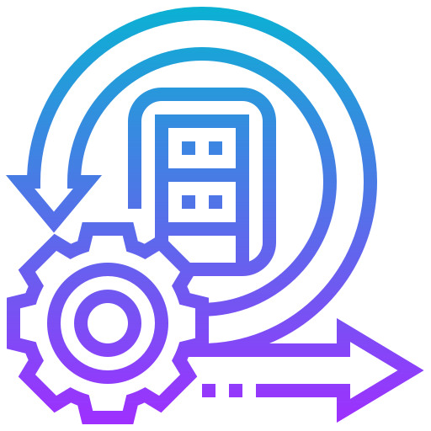
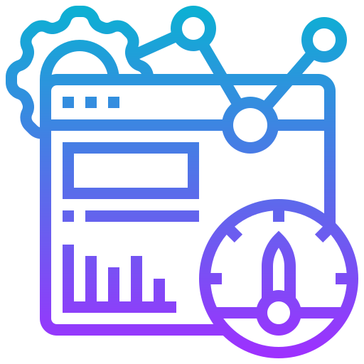

Pegasus Workflow Management System
Automates the execution of scientific workflows across CI
Provides a portable workflow description
Automates repetitive and time-consuming tasks
Reduces human error
Increases productivity
Data Management
Pegasus handles data transfers, input data selection and output registration by adding them as auxiliary jobs to the workflow
Error Recovery
Pegasus handles errors by retrying tasks, workflow-level checkpointing, re-mapping and alternative data sources for data staging
Provenance Tracking
Pegasus allows users to trace the history of a workflow and its outputs, including information about data sources and softwares used
Heterogeneous Environments
Pegasus can execute workflows in a variety of distributed computing environments such as HPC clusters, Amazon EC2, Google Cloud, Open Science Grid or ACCESS

Slide 28
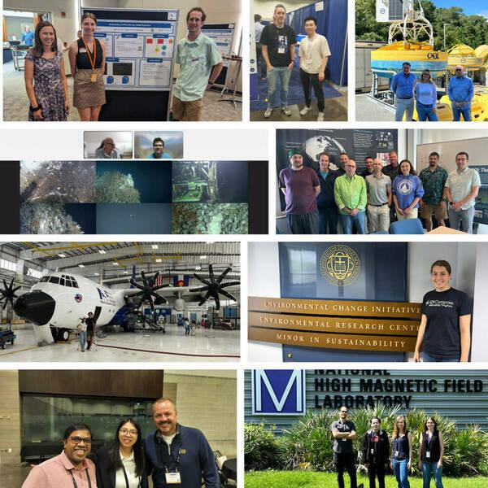
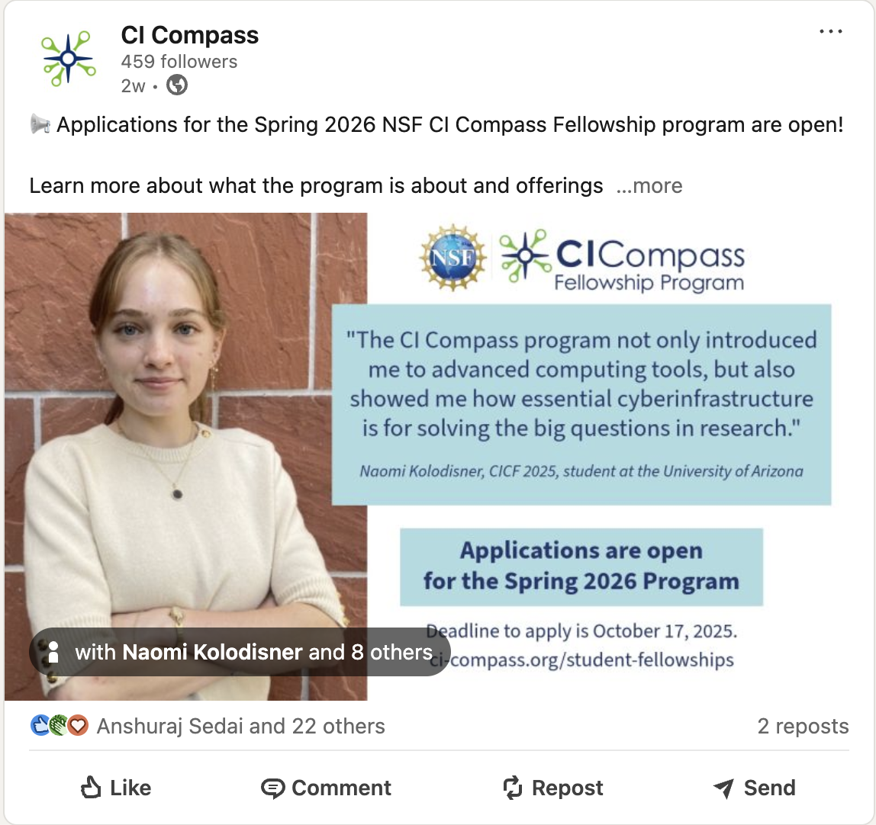
CI Compass Fellowship Program (CICF)
For Undergrads!
and Faculty mentors
Goal: Broaden student participation in CI research, development, deployment, and operations
Virtual Spring Program
Free to undergraduate students. Possibility of course credit.
Technical Skills Component: Students are taught technical skills relevant to CI.
Data Lifecycle Component: Students research MFs and the data lifecycle to understand the importance and context of MFs, and the related data and CI. They present their results at the end of the Spring Program.
(Optional/Invited) Summer Program
We collaborate with MFs to provide CI-related summer projects for some of our student fellows.
In-person or virtual, depending on the MF/project.
Students are paid for their participation.
https://ci-compass.org/
Major Facilities are large-scale NSF-funded science projects:
Telescopes, Research Vessels, Ecological and Ocean Observatories
Notes:
The goal of our CI Compass Fellowship Program is to introduce cyberinfrastructure and major facilities to undergraduate students as viable and exciting career options.
CICF consists of two programs: the Spring Program and the Summer Program.
The Spring Program is a 12-week virtual training program during the Spring Semester, which is free to students and can be taken as course credit, depending on their institution’s requirements.
During the program, students develop technical and research skills important to CI within the context of the data life cycles at MFs.
We also have an optional, invited, and paid summer program where students work with CI practitioners at MFs on a hands-on project, to continue to hone their skills. This summer we have eleven students working with NCAR, OOI, MagLab, Globus Labs, and the University of Notre Dame Environmental Research Center.

Slide 29
More Information About the Projects:
Pegasus: http://pegasus.isi.edu
Pegasus support: https://pegasus.isi.edu/contact/
PegasusAI: http://pegasusai.io
ACCESS Support: https://support.access-ci.org/
CI Compass: https://ci-compass.org
pegasus@isi.edu
Pegasus coming to Laguna
NAIRR AI Workshop at USC January 22, 2026
https://nairrpilot.org/
Big Thanks to DOE and NSF for the support!

